Slide 1
Language Modeling
Introduction to N-grams

Slide 2
Language Model
Sentence is sequence of words.
To find the probability of statements/Words/Characters ,there is need of Language model
N-gram is one of the basic Language model in NLP

Slide 3
Definition of language model
Any model that computes probability of the sentences (sequence of words) or probability of new wors when probability of other words are given.
Eg ."about ten minutes from...."{to predict word after from}
Eg attend c....{to predict next character class or college}

Slide 4
Probabilistic Language Models
Today’s goal: assign a probability to a sentence or sequence of words
It is a probability distribution over word sequence
models that assign a probability to each possible next word
Such a model, for example, could predict that the following sequence has a much higher probability of appearing in a text

Slide 5
Why?
Machine Translation:
P(high winds tonite) > P(large winds tonite)
Spell Correction
The office is about fifteen minuets from my house
P(about fifteen minutes from) > P(about fifteen minuets from)

Slide 6

It is essential in machine translation
As part of the process, we might have built the following set of potential rough English translations:
he introduced reporters to the main contents of the statement
he briefed to reporters the main contents of the statement
he briefed reporters on the main contents of the statement

Slide 7
Why ?
Speech Recognition
P(I saw a van) >> P(eyes awe of an)
+ Summarization, question-answering, etc., etc.!!
OCR(optical character recognition) & Hand Recognition
In, OCR LM can be used to predict a word that is not easily readable in the given image .

Slide 8
Why ?
Suggestions while typing
We get suggestion on our cell phone while messaging
Context Sensitive Spelling Correction
Eg. "college is closed on Saturday and Sunday
Spelling error : college has been typed as collage
College :Education institution
Collage : Artwork
Suppose both words college and collage are present in corpus .
Spelling Mistake detection and correction will not work as both words are present in corpus.
Need Spelling Correction based on local context.
P(College is closed on Saturday and Sunday )> p(Collage is closed on Saturday and Sunday )

Slide 9
Probabilistic Language Modeling
Goal: compute the probability of a sentence or sequence of words:
P(W) = P(w₁,w₂,w₃,w₄,w₅…w_{n}) Joint Probability
Related task: probability of an upcoming word:
P(w₅|w₁,w₂,w₃,w₄) Conditional Probability
A model that computes either of these:
P(W) or P(w_{n}|w₁,w₂…w_{n-1}) is called a language model.
Better: the grammar But language model or LM is standard

Slide 10
N Gram Model
the simplest model that assigns probabilities to sentences and sequences of words
An n-gram is a sequence n-gram of n words:
a 2-gram (which we’ll call bigram) is a two-word sequence of words like “please turn”, “turn your”, or ”your homework”, and
a 3-gram (a trigram) is a three-word sequence of words like “please turn your”, or “turn your homework”.

Slide 11
How to estimate these probabilities
Could we just count and divide?
No! Too many possible sentences!
We’ll never see enough data for estimating these

Slide 12
Method of estimating probabilities directly from counts
With a large enough corpus, such as the web, we can compute these counts and estimate the probability from above equation .
While this method works fine in many cases, but in most cases, it turns out that even the web isn’t big enough to give us good estimates .
This is because language is creative; new sentences are created all the time, and we won’t always be able to count entire sentences.
Even simple extensions of the example sentence may have counts of zero on the web (such as “Walden Pond’s water is so transparent that the”; well, used to have counts of zero)

Slide 13
How to compute P(W)
How to compute this joint probability:
P(its, water, is, so, transparent, that)
Intuition: let’s rely on the Chain Rule of Probability

Slide 14
Reminder: The Chain Rule
Recall the definition of conditional probabilities
p(B|A) = P(A,B)/P(A) Rewriting: P(A,B) = P(A)P(B|A)
More variables:
P(A,B,C,D) = P(A)P(B|A)P(C|A,B)P(D|A,B,C)
The Chain Rule in General
P(x₁,x₂,x₃,…,x_{n}) = P(x₁)P(x₂|x₁)P(x₃|x₁,x₂)…P(x_{n}|x₁,…,x_{n-1})

Slide 15
The Chain Rule applied to compute joint probability of words in sentence
P(“its water is so transparent”) =
P(its) × P(water|its) × P(is|its water)
× P(so|its water is) × P(transparent|its water is so)

Slide 16
Chain Rule Explained
link between
computing the joint probability (probability of entire sequence of words)
and
computing the conditional probability(probability of a word given previous words.)
the joint probability of an entire sequence of words by multiplying together several conditional probabilities.

Slide 17
N gram model
It says that instead of computing the probability of a word given its entire history, we can approximate the history by just the last few words.
For Example, bigram
The bigram model, for example, approximates the probability of a word given all the previous words P(wn|w1:n−1)
by using only, the conditional probability of the preceding word P(wn|wn−1).

Slide 18
Example
instead of computing the probability
P(the|Walden Pond’s water is so transparent that)
we approximate it with the probability
P(the|that)

Slide 19
Bigram Model
When we use a bigram model to predict the conditional probability of the next word, we are thus making the following approximation:
P(wn|w1:n−1) ≈ P(wn|wn−1)
The assumption that the probability of a word depends only on the previous word is called a Markov assumption

Slide 20
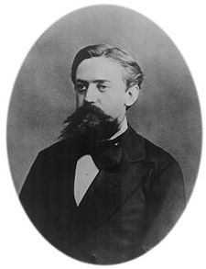
Markov Assumption
Simplifying assumption:
Or maybe
Andrei Markov

Slide 21
Markov Assumption
In other words, we approximate each component in the product

Slide 22
Language Modeling
Estimating N-gram Probabilities

Slide 23
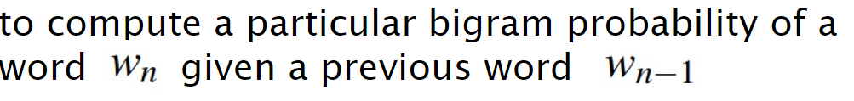
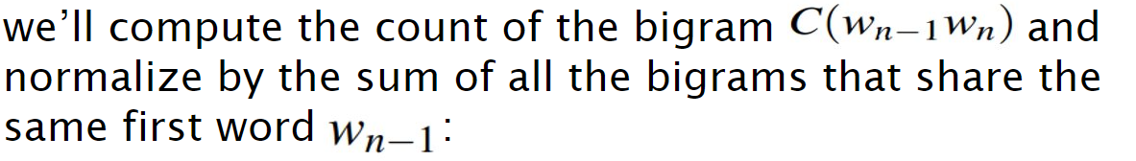
How do we estimate these bigram or n-gram probabilities?

Slide 24
How do we estimate these bigram or n-gram probabilities?
The Maximum Likelihood Estimate

Slide 25
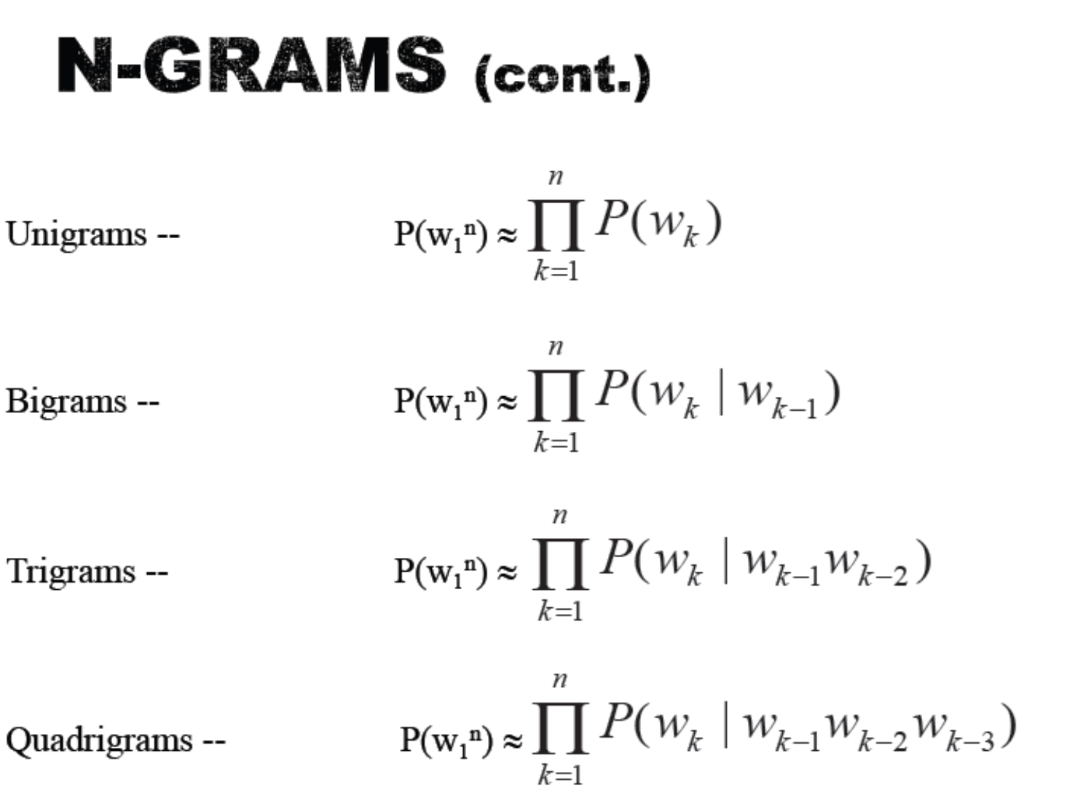

Slide 26
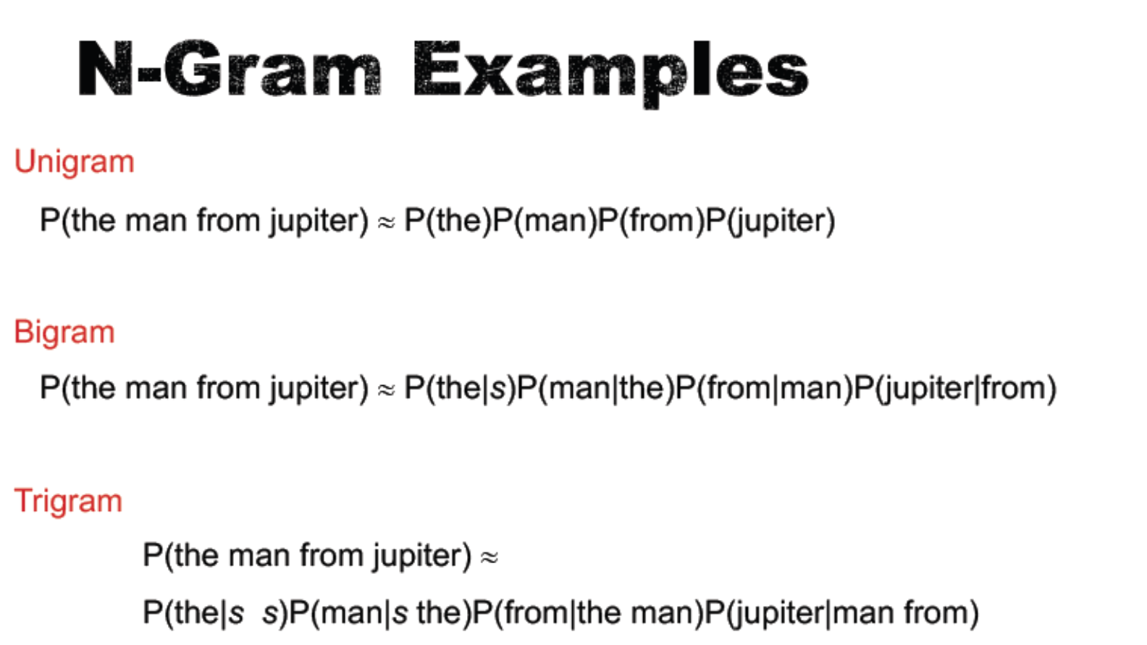

Slide 27

An example
<s> I am Sam </s>
<s> Sam I am </s>
<s> I do not like green eggs and ham </s>

Slide 28
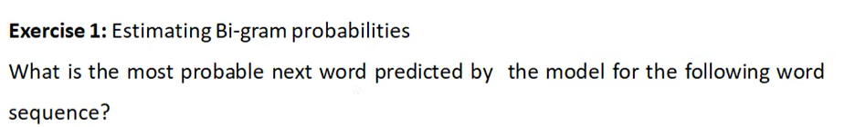
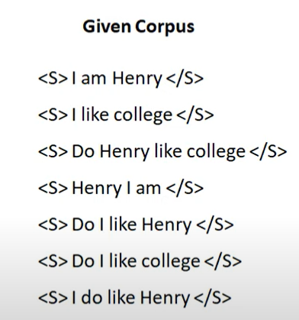
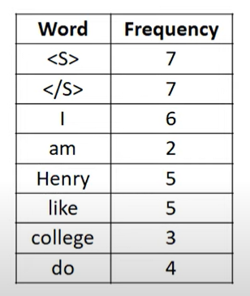

Slide 29


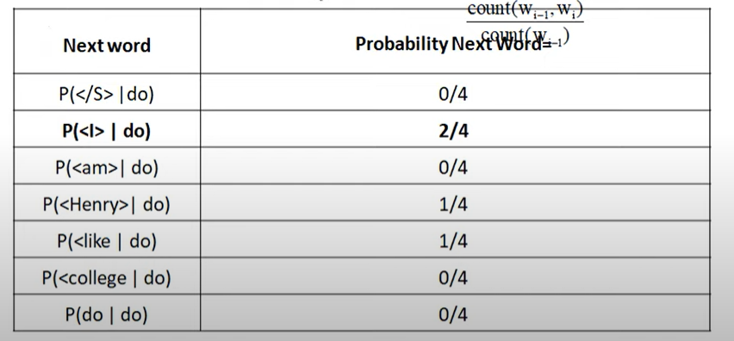

Slide 30

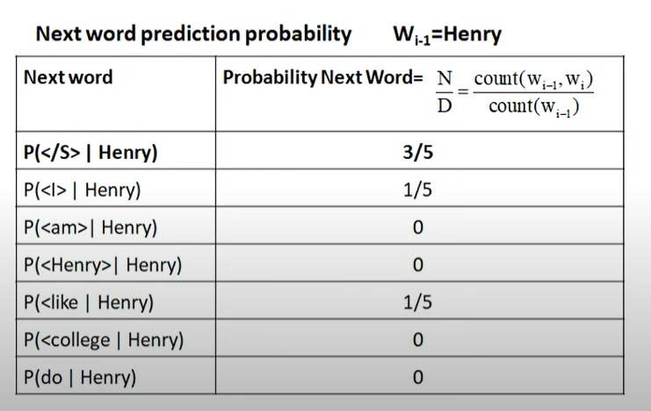


Slide 31
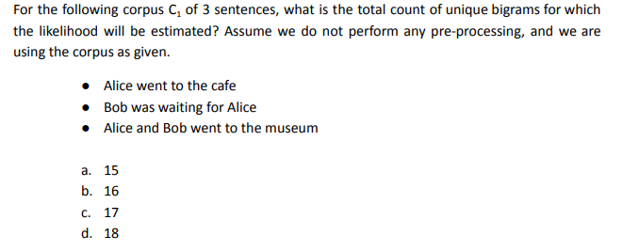
Questions

Slide 32
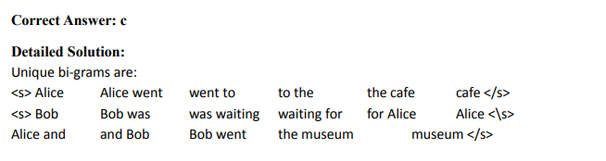
Solution

Slide 33
More examples: Berkeley Restaurant Project sentences
can you tell me about any good cantonese restaurants close by
mid-priced Thai food is what I'm looking for
tell me about chez panisse
can you give me a listing of the kinds of food that are available
i’m looking for a good place to eat breakfast
when is caffe venezia open during the day

Slide 34
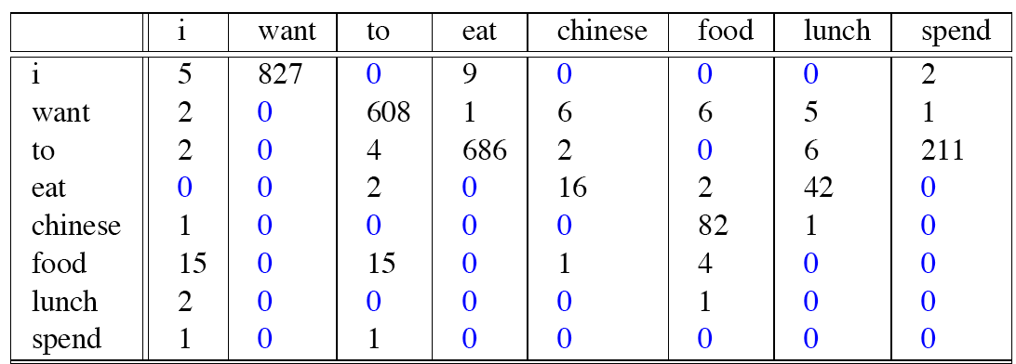
Raw bigram counts
Out of 9222 sentences

Slide 35
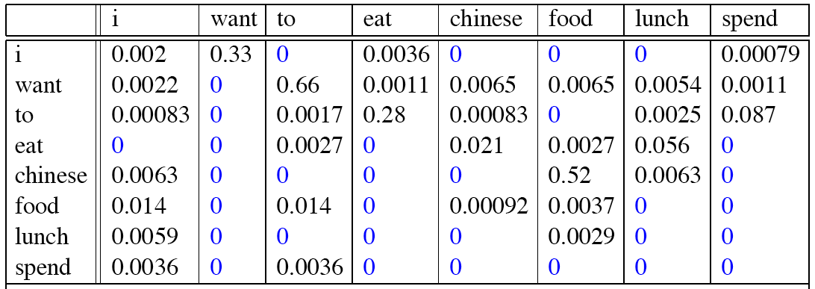
Raw bigram probabilities
Normalize by unigrams:
Result:

Slide 36
Bigram estimates of sentence probabilities
P(<s> I want english food </s>) =
P(I|<s>) × P(want|I) × P(P(english|want) × P(P(food|english) x P(</s>|food)d)
= .000031

Slide 37
What kinds of knowledge?
P(english|want) = .0011
P(chinese|want) = .0065
P(to|want) = .66
P(eat | to) = .28
P(food | to) = 0
P(want | spend) = 0
P (i | <s>) = .25

Slide 38
Practical Issues
We do everything in log space
Avoid underflow
(also adding is faster than multiplying)

Slide 39
Log Probabilities
Since probabilities are less than or equal to 1, the more probabilities we multiply together, the smaller the product becomes.
Multiplying enough n-grams together would result in numerical underflow.
By using log probabilities instead of raw probabilities, we get numbers that are not as small.
Adding in log space is equivalent to multiplying in linear space, so we combine log
probabilities by adding them.
adding is faster than multiplying
The result of doing all computation and storage in log space is that we only need to convert back into probabilities if we need to report them at the end
log(p₁ ×p₂ ×p₃ ×p₄ ) =log p₁ +log p₂ + log p₃ + log p₄

Slide 40
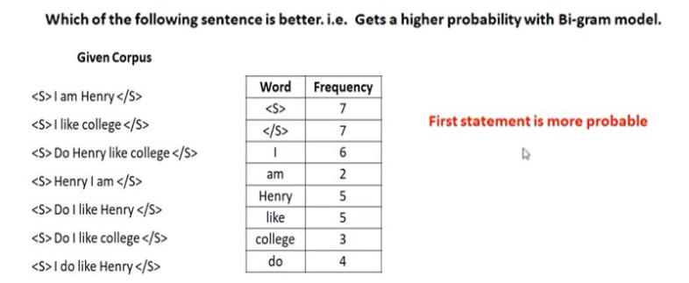
Example

Slide 41
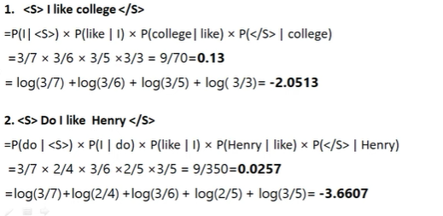
Example

